Slide 1
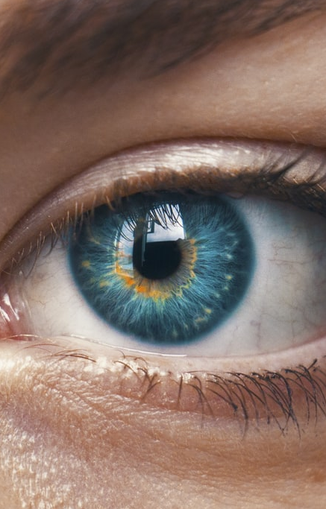
cml1 Medical Challenge
Final Presentation
Notes:
Sehr geehrtes Experten Team, lieber Heinz. Ich begrüsse sie zu meiner Präsentation zu meiner IPA mit dem Titel «KMU Netzwerk mit virtuellen Servern und Arbeitsstationen»

Slide 2

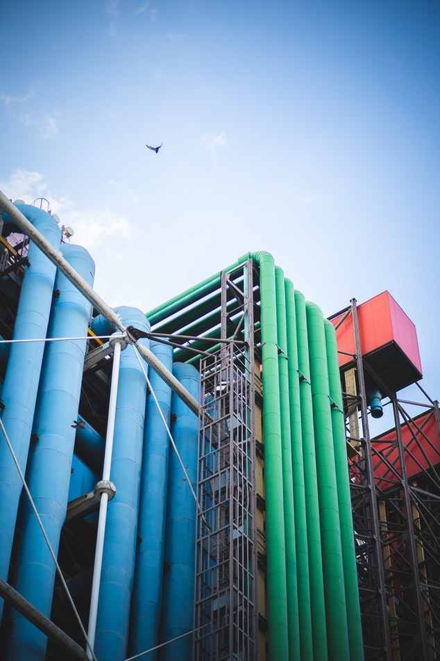
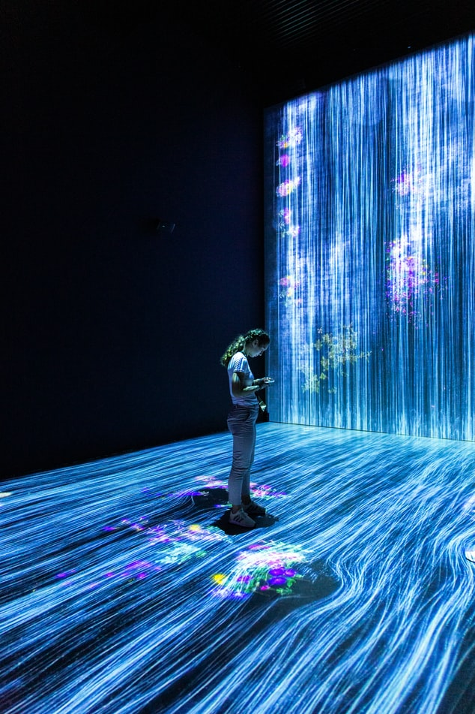

Agenda
Introduction
EDA/Preprocessing
Modeling/Results
Conclusion/Q&A
Notes:
Zu Beginn möchte ich kurz den Ablauf der Präsentation aufzeigen. Als erstes werde ich Ihnen kurz die Thematik bzw. die Aufgabenstellung der Arbeit erklären und komme danach gleich auf die Planungsphase zu sprechen. Am Ende noch kurz ein paar Dinge zur Umsetzung des Projektes und dann geht es schon weiter zur Demonstration.

Slide 3
Introduction
EDA/Preprocessing
Modeling
Results
Project
Data description
Goal
Classification on target features
Identification of important feature subset
Approach
EDA
Preprocessing
Model identification
Feature importance extraction
1075 samples (426 male, 649 female)
64 attributes (excluding «range» and «UOM»)
Mixture of categorical and numerical attributes
Added «uveitis»-attribute
«HLA»-Features not considered
712
3
Models
Datasets
52
9
Preprocessing Combinations
Datasets

Slide 4
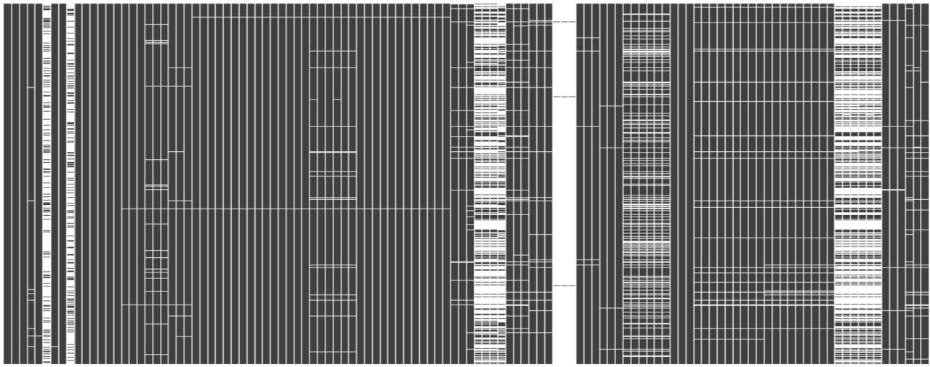
Introduction
EDA/Preprocessing
Modeling
Results
Explorative Data Analysis
Different features and varying amounts of missing values
Possible approaches
Removable columns
Missing values strategies
Notes:
Missing values strategy, visulization of missings
Consider modular approach
“_others” and “notes” 79.07% missing
“anti-dnase_b” 99.63% of missing
“beta-2-microglobulin” and “lupus_anticoagulant” approx. 65% missing
UOM formatting (data inconsistencies)
Formatting errors (C to NaN etc)

Slide 5
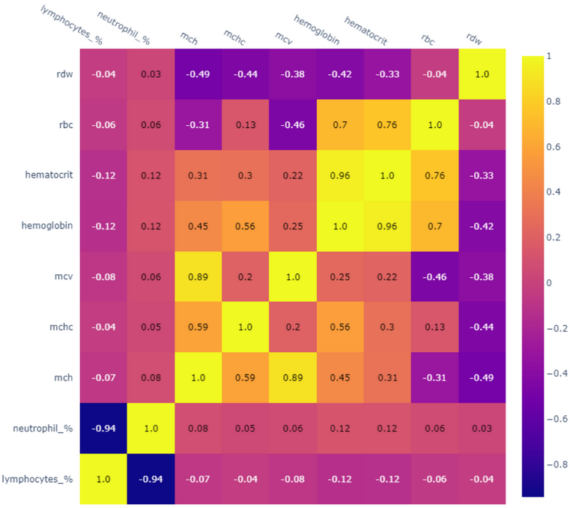
Introduction
EDA/Preprocessing
Modeling
Results
Explorative Data Analysis
Correlation Matrix
Visualized
Additional insights
Evaluate
Gain insights
Prepare
Notes:
Possible next steps, to gain additional insight, could include comparing correlations between different uveitis categories, location, and specific diagnosis.

Slide 6
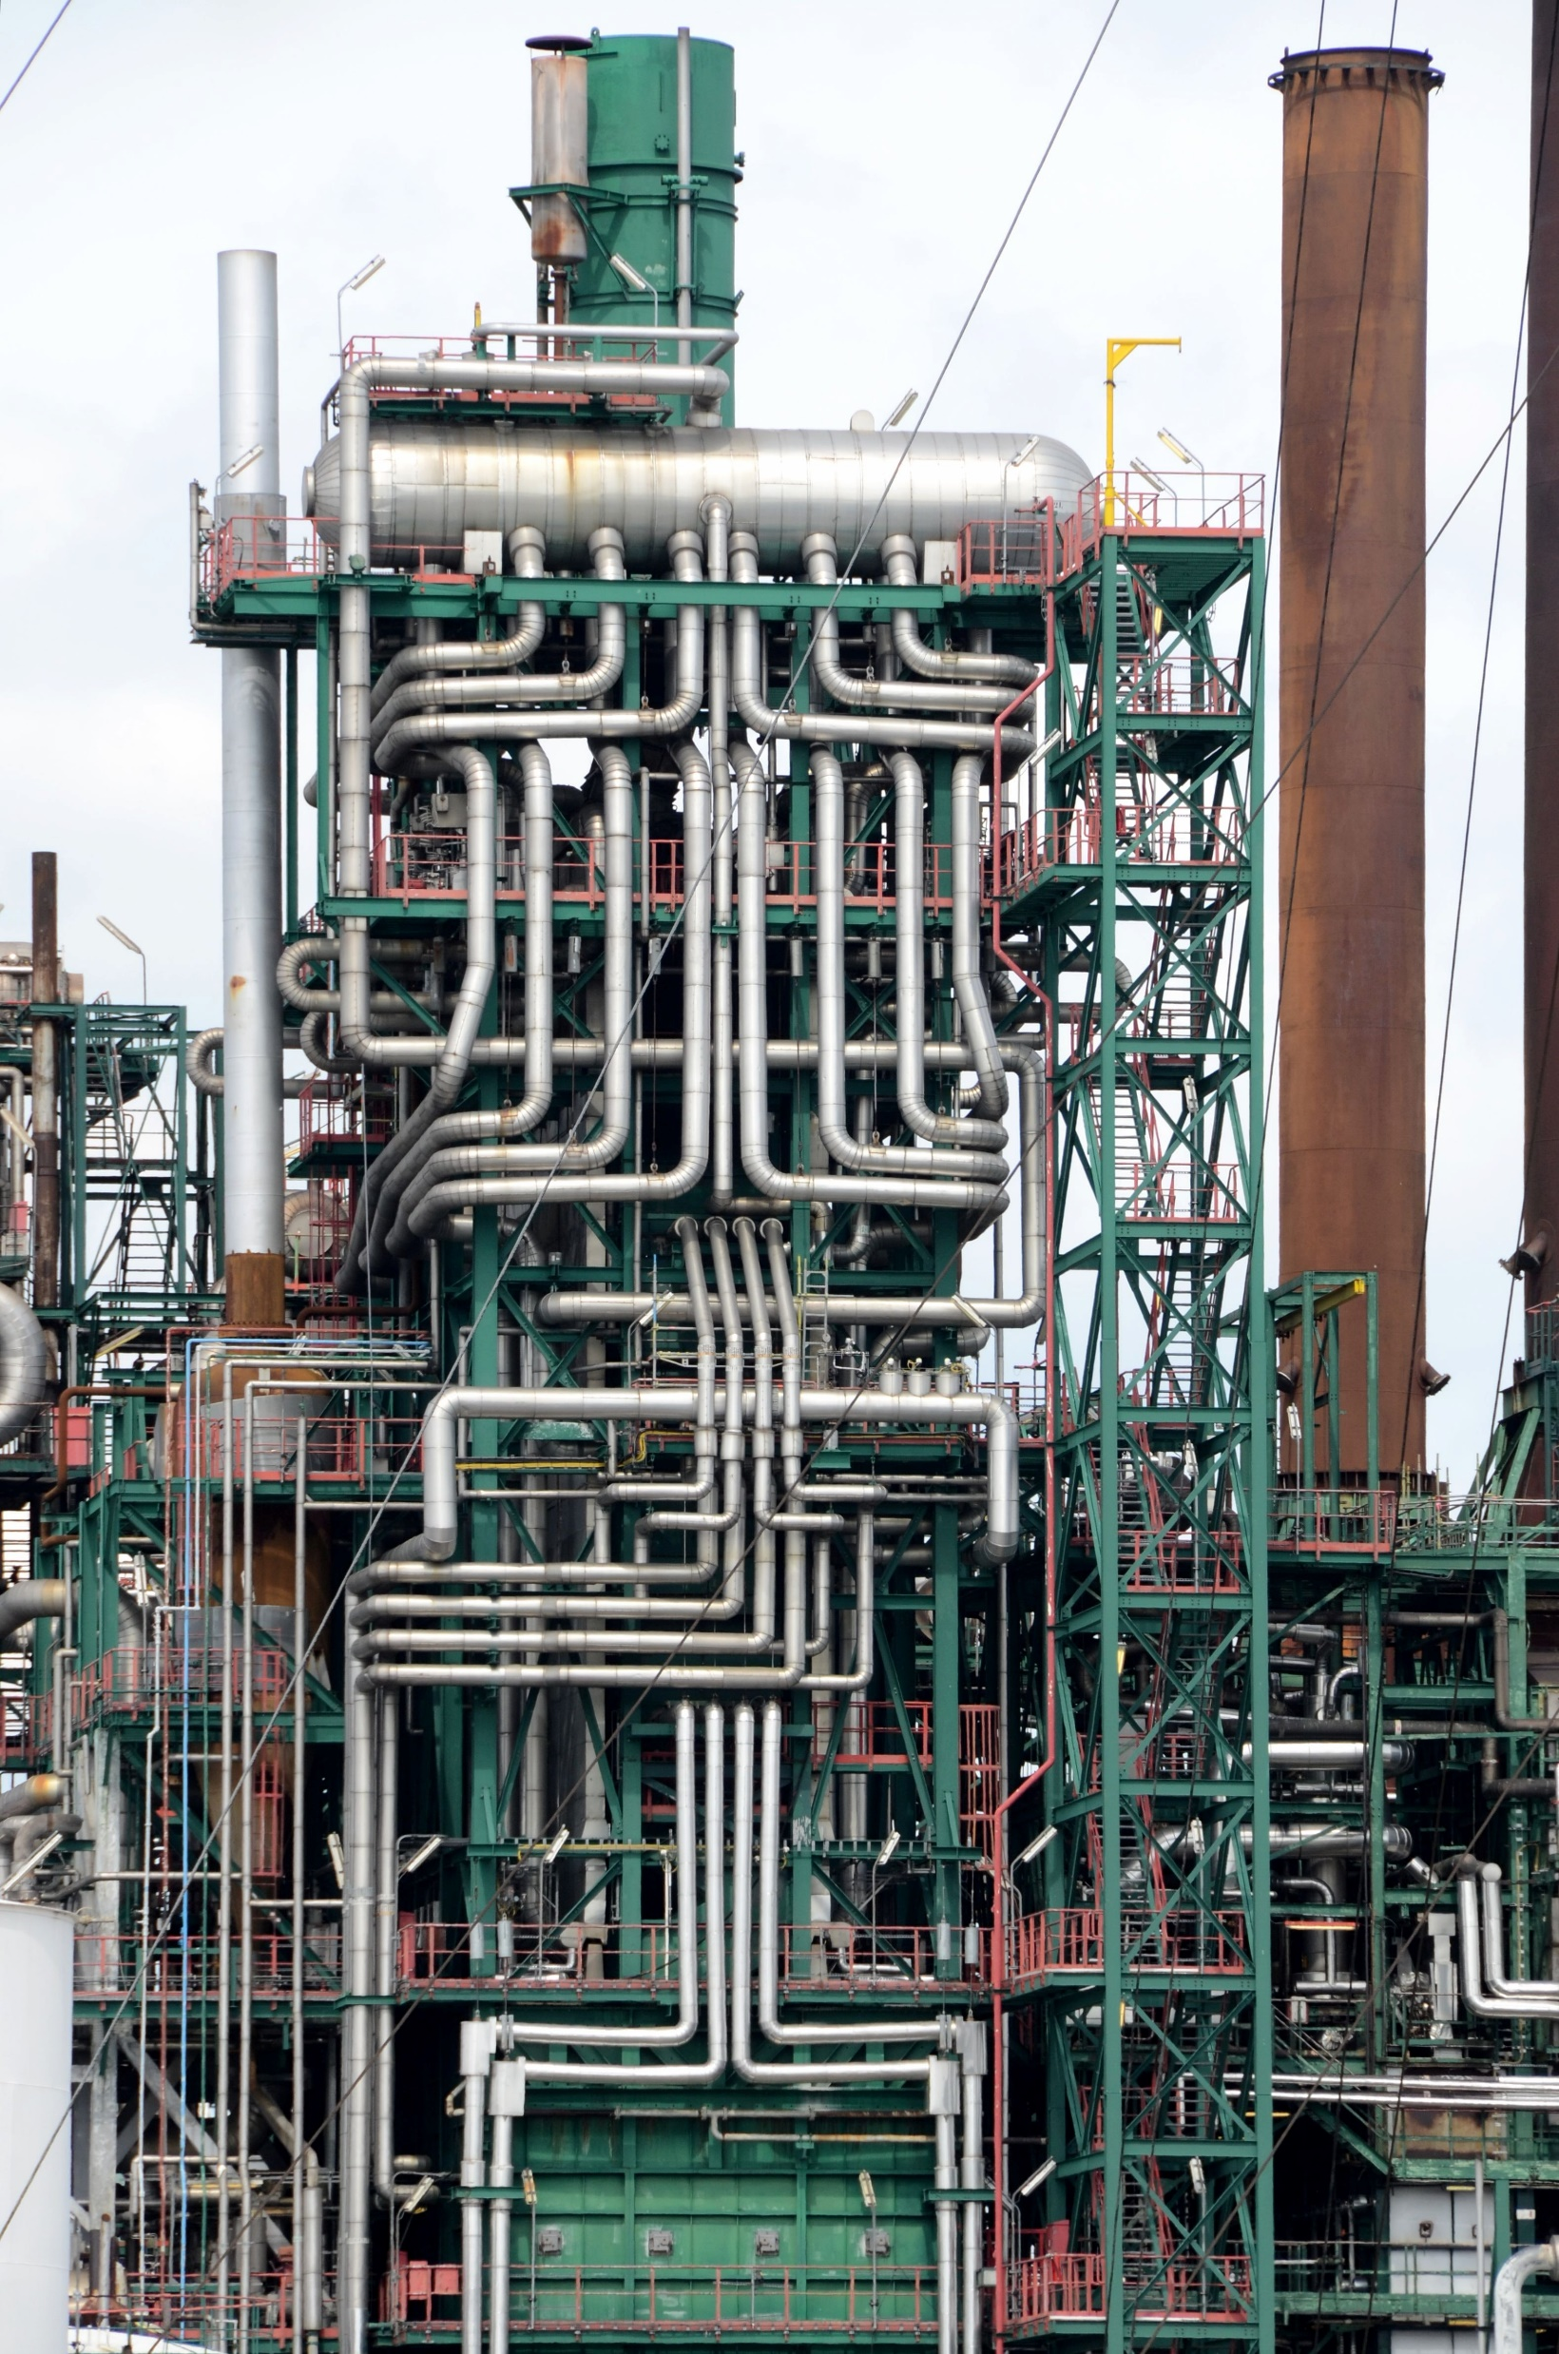
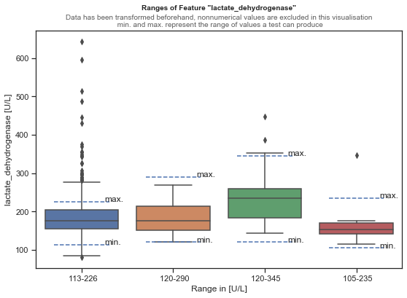
Introduction
EDA/Preprocessing
Modeling
Results
Preprocessing-Pipeline
Clean-up
High percentage of missing values
Categorical Features
Collapsing “location”
Collapsing “category”
Collapsing “specific_diagnosis” (sub 20 occurrences → “other”)
Numerical Features
UOM-Fix
“Range”-Features to dtype Categorical
Mixed Dtype Features → dtype Categorical
Imputing missing values
Options:
sklearn-SimpleImputer
→ Mean & Most Frequent
k-nearest Neighbours (k=3) (KNNImputer)
Encoder
Goal: Transform data into machine readable format
OneHot-Encoding
Label Encoder
Combinations
OneHotEncoding + SimpleImputer
OneHotEncoding + KNNImputer
LabelEncoder + SimpleImputer
LabelEncoder + KNNImputer

Slide 7
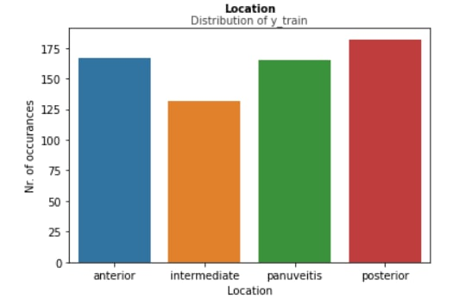
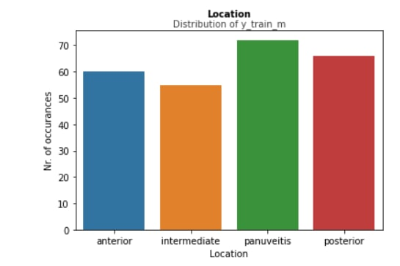
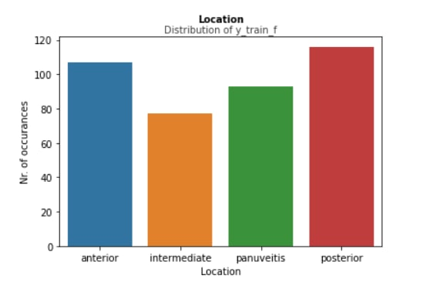
Introduction
EDA/Preprocessing
Modeling
Results
Modeling
Comprehensibility
Reproducibility
Feature importance extraction
Classification Algorithms
Decision Trees
Random Forest
K-nearest Neighbours (KNN)
Support Vector Machines (SVM)
XGBoost
AdaBoost w/ DecisionTree as Base
Multi-Layer Perceptron (MLP)
Notes:
Goal of modeling
3 datasets (male, female, both and distribution for location)
7 classification algorithms

Slide 8

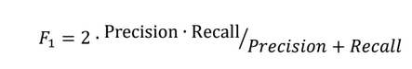
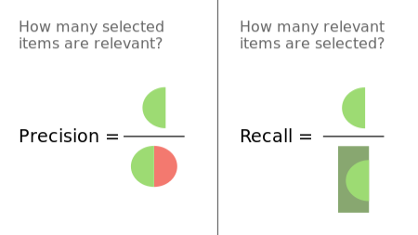
Introduction
EDA/Preprocessing
Modeling
Results
Modeling
Train-test set (.75, .25)
Stratified split
Grid Search Approach
Cross-validation
Two Target Metrics
F1-Score
Precision
Recall
Harmonic mean
Macro-F1
Balanced Accuracy
Notes:
Train test split
Stratified split: the training and test sets have the same underlying distribution.
Grid search approach: hyperparameter optimization; also called parameter sweep, exhaustive search through specified subset of hyperparameter space, guided by crossvalidation as performance metric
Cross-validation: estimate how accurately a predictive model will perform in practice, cross-validation can be used for checking whether the model has been overfitted
Harmonic mean: Typically, it is appropriate for situations when the average rate is desired.
Balanced accuracy: accuracy of true positives and true negatives

Slide 9
Introduction
EDA/Preprocessing
Modeling
Results
Modeling
Location prediction
All 7 algorithms tested
Binary approach
Anterior & Posterior
Macro-F1 0.49 expected 0.5
Multiclass approach
Four classes
Macro-F1 0.24 expected 0.25
One vs. All approach
Extract feature importance
XGBoost
Category prediction
Decision Tree
Macro-F1 0.24 expected 0.25
Specific Diagnosis
All 7 algorithms tested
Idiopathic undersampling
And other steps
27 to 12 classes
Macro-F1 0.07 0.083 expected
Notes:
Baseline F1-score or Macro-F1 for multiclass prediction

Slide 10
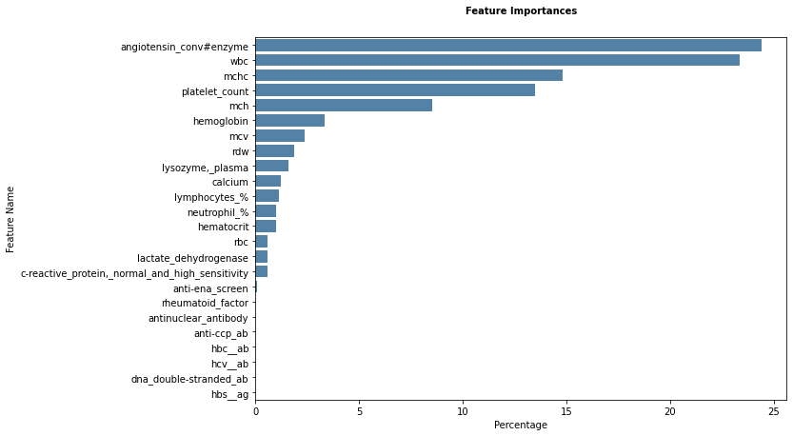
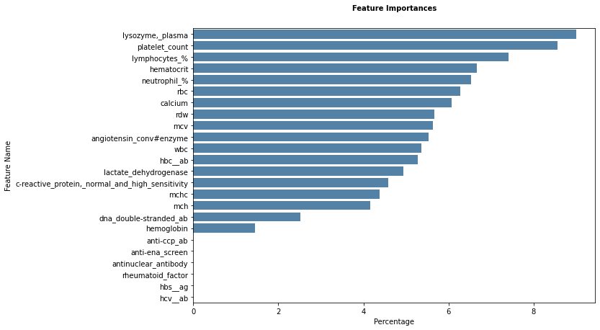
Introduction
EDA/Preprocessing
Modeling
Results
Location: Binary
Macro F1-Score
Dataset | Strategy | Algorithm | Baseline | Score | Std^{a.}
Complete | OneHot | XGBoost | 0.49 | 0.54 | ±0.04
Male | No OneHot | AdaBoost | 0.52 | 0.63 | ±0.02
Female | KNNImputer | XGBoost | 0.57 | 0.58 | ±0.006
Balanced Accuracy
Dataset | Strategy | Algorithm | Baseline | Score | Std
Complete | OneHot | XGBoost | 0.48 | 0.56 | ±0.033
Male | OneHot+KNN | AdaBoost | 0.51 | 0.65 | ±0.048
Female | KNNImputer | XGBoost | 0.57 | 0.58 | ±0.008
Location: Multiclass
Fig. 7, Feature importance for male, positive uveitis data with AdaBoost and balanced accuracy
Macro F1-Score
Dataset | Strategy | Algorithm | Baseline | Score | Std
Complete | KNNImputer | XGBoost | 0.24 | 0.31 | ±0.009
Male | OneHot | AdaBoost | 0.32 | 0.33 | ±0.052
Female | KNNImputer | Decision Tree | 0.25 | 0.33 | ±0.042
Balanced Accuracy
Dataset | Strategy | Algorithm | Baseline | Score | Std
Complete | OneHot+KNN | XGBoost | 0.24 | 0.32 | ±0.009
Male | OneHot | MLP | 0.32 | 0.36 | ±0.018
Female | KNNImputer | Decision Tree | 0.25 | 0.36 | ±0.026
Fig.8, Feature Importance for complete, positive uveitis data with XGBoost
Bildquelle: unsplash.com

Slide 11
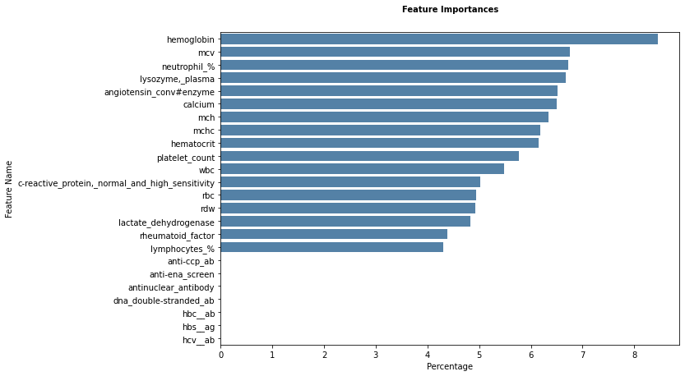
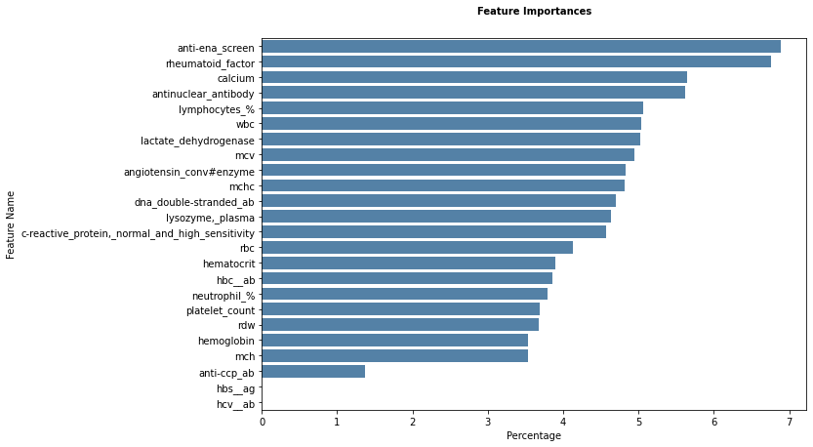
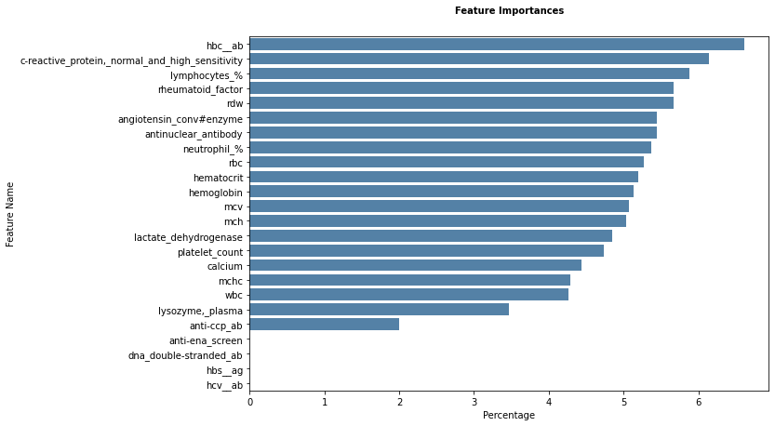
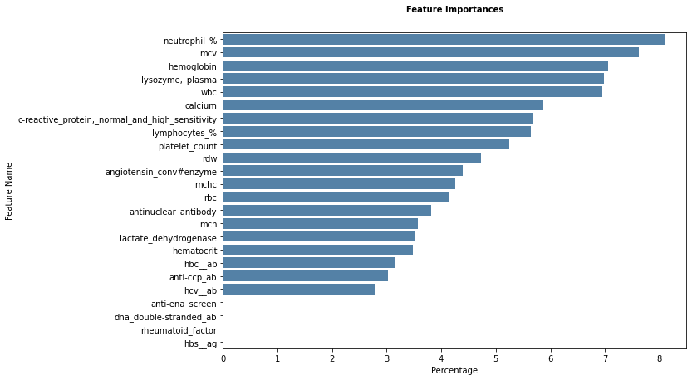
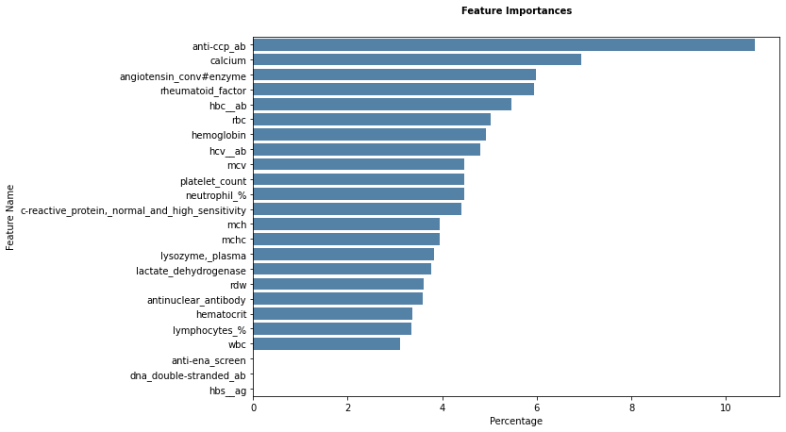
Introduction
EDA/Preprocessing
Modeling
Results
Location: One vs. All
Anterior vs. All
Intermediate vs. All
Macro F1-Score
Class | F1-Score |  |  | Balanced Accuracy
 | Strategy | Score | Std | Strategy | Score | Std
Anterior | KNNImputer | 0.51 | ±0.034 | KNNImputer | 0.53 | ±0.024
Intermediate | OneHot | 0.47 | ±0.04 | OneHot | 0.49 | ±0.014
Panuveitis | OneHot+KNN | 0.51 | ±0.033 | OneHot+KNN | 0.52 | ±0.021
Posterior | OneHot+KNN | 0.53 | ±0.016 | OneHot+KNN | 0.53 | ±0.017
Scleritis | KNNImputer | 0.48 | ±0.0003 | OneHot+KNN | 0.5 | ±0.015
Fig. 8, Feature Importance of "Anterior vs. All", XGBoost,
Fig. 9, Feature Importance of "Intermediate vs. All", XGBoost
Panuveitis vs. All
Posterior vs. All
Scleritis vs. All
Fig. 10, Feature Importance of "Panuveitis vs. All", XGBoost
Fig. 11, Feature Importance of "Posterior vs. All", XGBoost
Fig. 12, Feature Importance of "Scleritis vs. All", XGBoost
Bildquelle: unsplash.com

Slide 12
Introduction
EDA/Preprocessing
Modeling
Results
Category (4 Classes)
Specific Diagnosis (12 Classes)
Macro F1-Score
Macro F1-Score
Dataset | Strategy | Algorithm | Baseline | Score | Std
Complete | OneHot | SVM | 0.24 | 0.32 | ±0.019
Male | OneHot | Decision Tree | 0.24 | 0.39 | ±0.038
Female | OneHot+KNN | KNN | 0.2 | 0.33 | ±0.005
Dataset | Strategy | Algorithm | Baseline | Score | Std
Complete | KNNImputer | KNN | 0.06 | 0.2 | ±0.021
Male | OneHot+KNN | XGBoost | 0.09 | 0.19 | ±0.017
Female | OneHot+KNN | SVM | 0.08 | 0.19 | ±0.015
Balanced Accuracy
Balanced Accuracy
Dataset | Strategy | Algorithm | Baseline | Score | Std
Complete | KNNImputer | Decision Tree | 0.24 | 0.32 | ±0.017
Male | OneHot+KNN | Decision Tree | 0.24 | 0.34 | ±0.04
Female | OneHot+KNN | KNN | 0.2 | 0.33 | ±0.01
Dataset | Strategy | Algorithm | Baseline | Score | Std
Complete | No OneHot | XGBoost | 0.06 | 0.18 | ±0.02
Male | No OneHot | Decision Tree | 0.1 | 0.22 | ±0.017
Female | OneHot+KNN | SVM | 0.08 | 0.24 | ±0.043
Bildquelle: unsplash.com

Slide 13
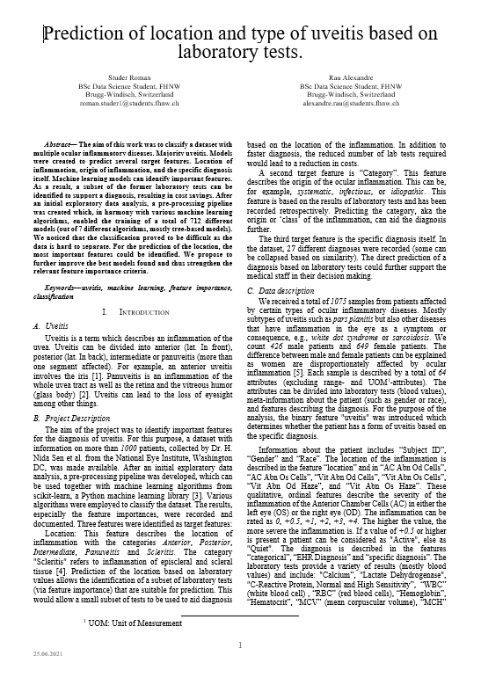
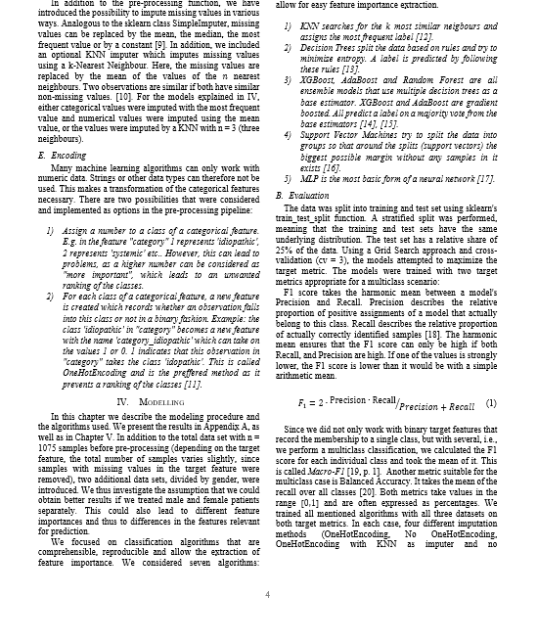
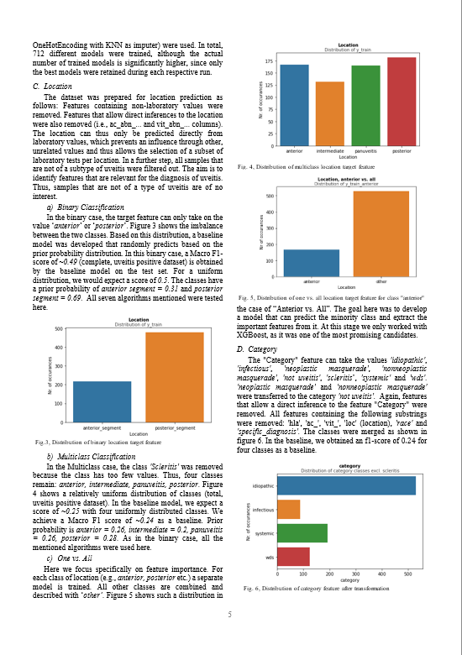
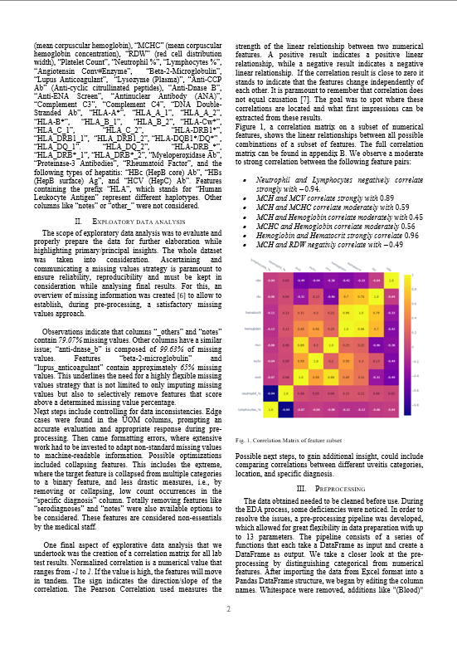
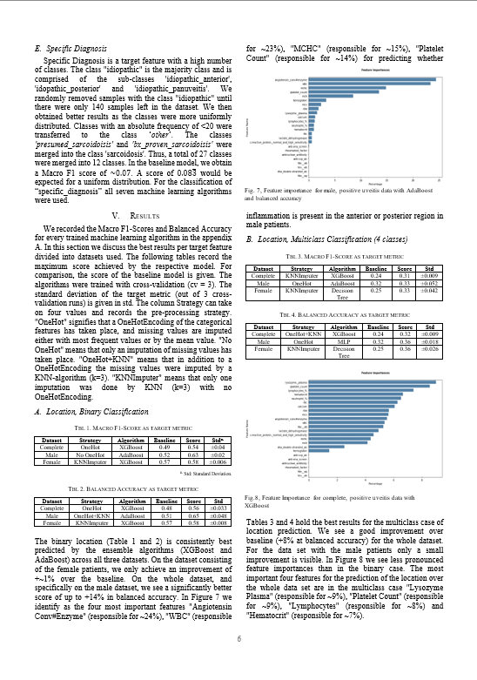
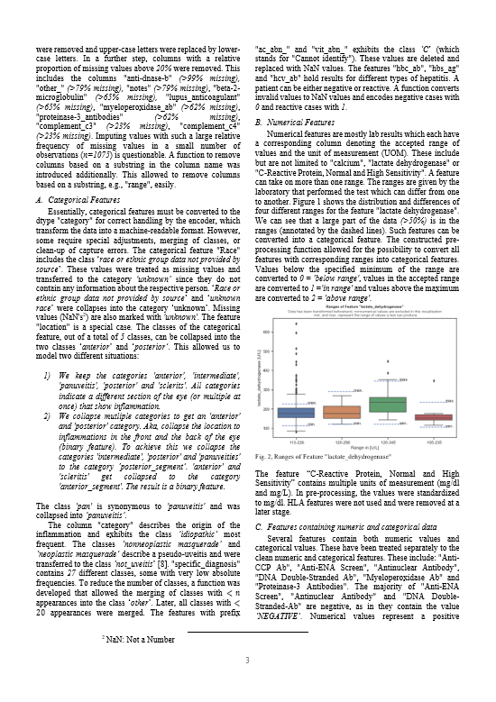
Conclusion
Introduction
EDA/Preprocessing
Modeling
Results
Hard to classify, overlapping groups
Class imbalance
Tree based ensemble models yield best results
Found important features per location, category or specific diagnosis overall
Some improvement by handling male and female patients differently
How to continue?
Refine models
Strengthen confidence in feature importance
Bildquelle: unsplash.com
Notes:
More in-depth in the paper and code is openly available at request

